Slide 1
Non-parental child care and the risk of respiratory infection

Slide 2

Short- and Long-term Risk of Infections as a Function of Group Child Care Attendance: An 8-Year Population-Based Study Côté et al (2010)
Prospective cohort with random selection of newborns in Quebec at t0
Yearly home interviews
Analyze 61% of participants who with all eight interviews
Notes:
Differential attrition occurred on the basis of the following 4 socioeconomic variables: maternal education, maternal immigration status, family income, and number of siblings.13 To ensure the representativeness of the sample, all the analyses were weighted. Weights were calculated on the basis of the 4 socioeconomic variables using the inverse probability weighting method. The weight procedure ensured that the analysis sample was similar to the initial representative sample and resulted in the absence of difference on all the variables included in the analyses.

Slide 3
Exposure
Outcome
Group child care attendance
Large (80 to 120 children)
Small (3 to 8 children in home)
Age at enrollment
Early start (<2.5 years)
Late start (>2.5 years)
4 categories compared to reference group (home care)
Frequency of child’s infections in the past 3 months
Respiratory tract infection
Ear infection
Gastrointestinal infection
Notes:
Interview questions: frequency of infections in the past 3 months at every data collection point. “In the past three months, how many times did your child experience the 3 following types of infection? (1) RTI with fever (eg, influenza), (2) ear infection (eg, otitis media), and (3) gastrointestinal tract infection with more than 1 day of diarrhea or vomiting.”

Slide 4
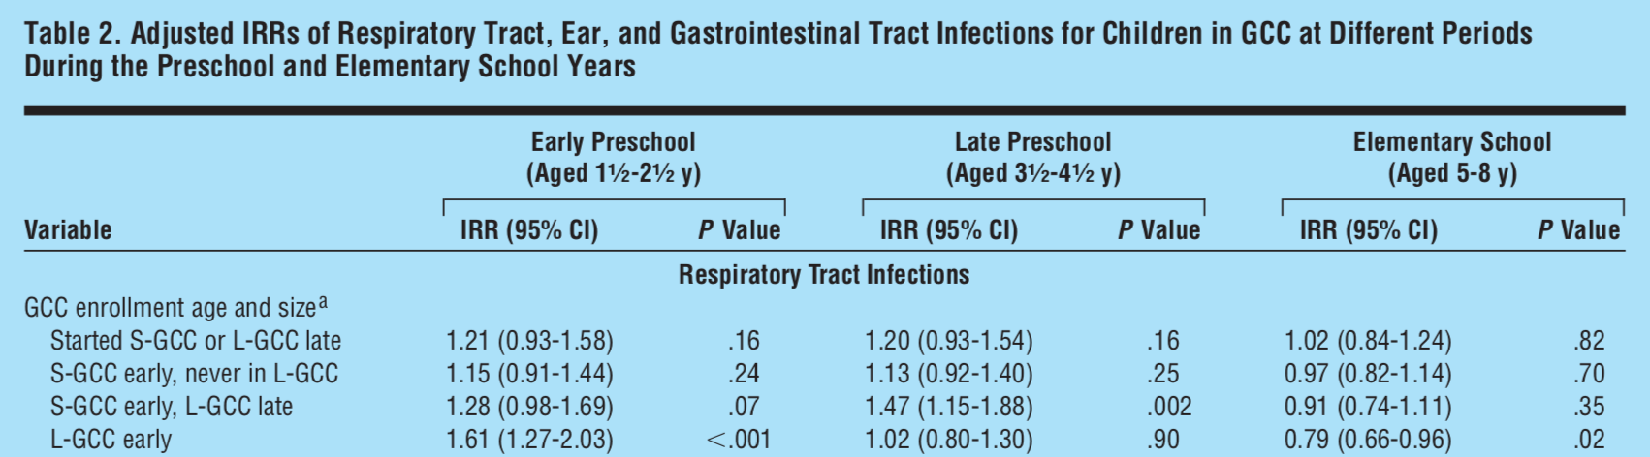
Child care acts as short-term risk factor and long-term benefit
Notes:
Regardless of size or time at enrollment, seems that children in CCCs are more at risk for illness than home care counter parts
This effect still holds in late preschool
By ages 5-8, now see an inverse effect….kind of in line with the hygiene hypothesis
Also differences between small and large group care…these effects are more pronounced in large group care. Unsurprisingly given that kids are around more kids and more germs. Large GCC kids experiencing 60% more illnesses in the past three months than home care counterparts, but 20% fewer illnesses between the ages of 5 and 8
Also interesting is that the attendance of large GCC isn’t enough. Compare L-GCC early to S-GCC early/L-GCC late…protective effects are not the same

Slide 5
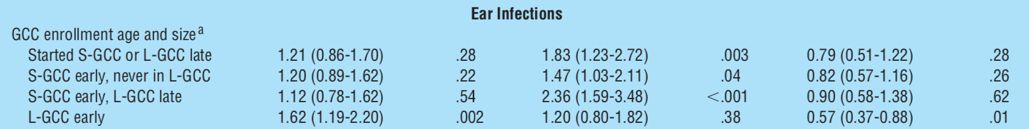
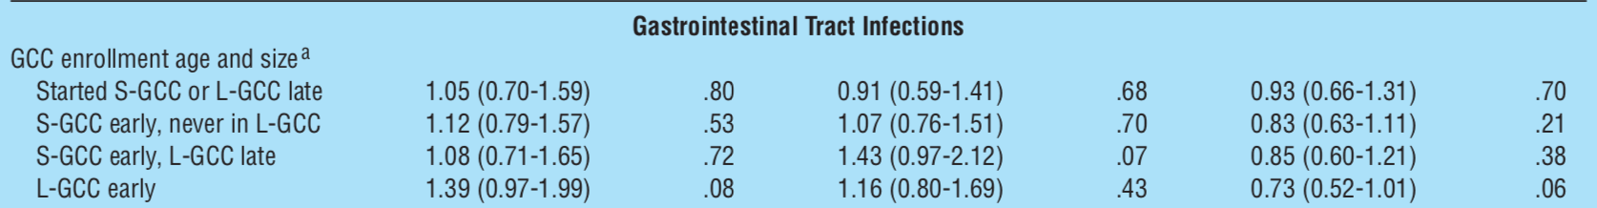
Same pattern observed for each type of illness

Slide 6
Are there any downsides to these early illnesses?
“Physicians may reassure parents whose children initiate large GCC early that their child’s experiencing infections is temporary and is likely to provide them with greater immunity during the elementary school years.”
Côté et al, 2010
Notes:
This is how they conclude the paper

Slide 7
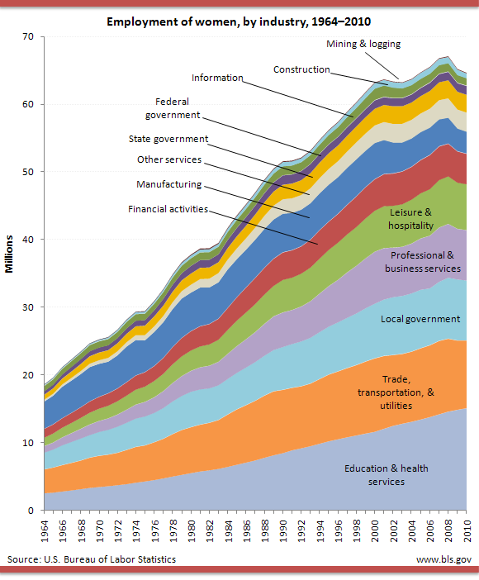

Yes!
US child care usage increasing
Two-thirds of all US children <5 attend child care
Children already at illness risk ARIs as most common childhood cause of morbidity
Family financial impact
> $700 per year for families with CCC children
Notes:
Who cares
30% of these children attending at least 10 hours of non-parental care per week
And this population bears a disproportionate burden of seasonal respiratory infection in a community

Slide 8

Proposed project: Prevent intra-facility illness transmission
Notes:
We only really know if child is attending CCC, cannot tell where they were infected which is the crux of this Aim

Slide 9
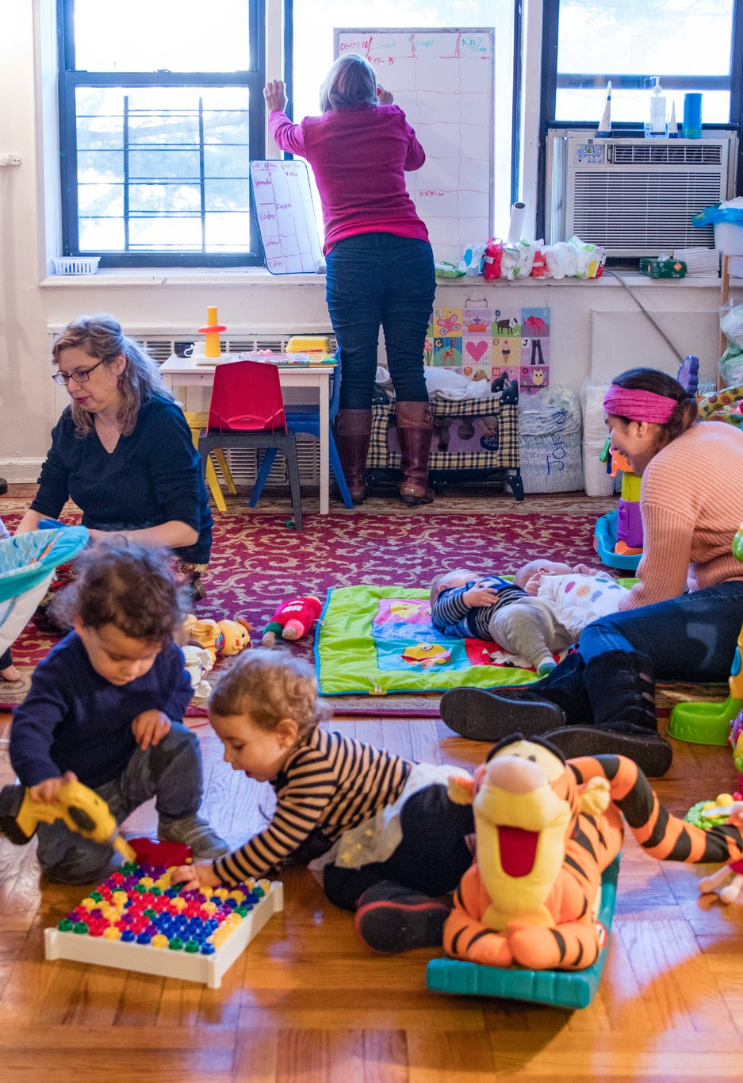

How relevant is current research or proposed interventions?
Notes:
Most data focusing on types of CCCs. Most studies agree that larger facilities experience higher illness risk than smaller HCCs.
These papers comment on child density, physical size of care facility…issue is that these are largely unmodifiable characteristics of CCCs. Similar to the characteristics/behaviors of children.
Compared to cleaning practices, hygiene policies, etc. In other words, identifying CCC policies that put children/communities at risk would be much more significant and impactful.

Slide 10
Social mixing as a potential alternative for intervention

Slide 11



Wide range of developmental stages in child care
Notes:
Infants – 0 to 2
Toddlers – 3 to 5ish
Preschoolers – 4.5ish to 6

Slide 12

Vaccination strategies against respiratory syncytial virus Yamin et al (2016)
Simulation model based on weekly US incidence rates
Parameters including viral load, contact rates, and behavior change when sick
Vaccine type and policy implications
Notes:
Almost all people infected with RSV by the age of 3. Severe impact on the very young and very old
Vaccine roll-out estimated in the next 5-10 years by the WHO

Slide 13



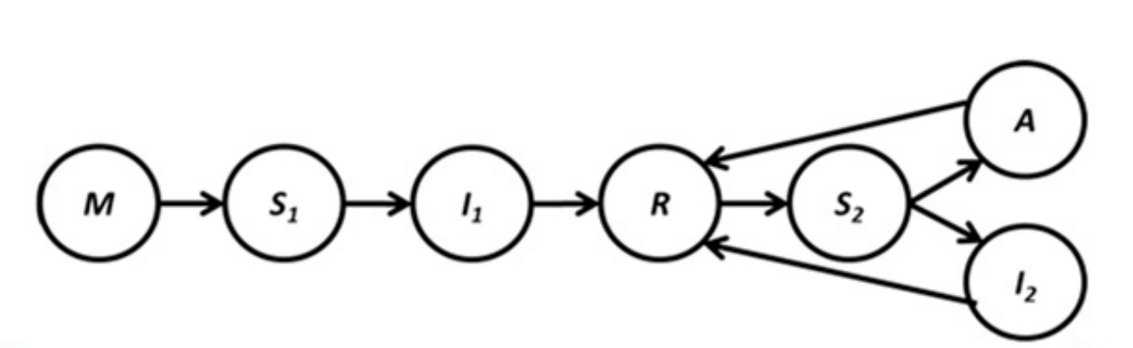
Yamin’s simulation model for RSV transmission
Susceptible
(first, subsequent)
Infected
(first, subsequent, asymptomatic)
Recovered (temporarily immune)

Slide 14



There are multiple factors that influence transmission
Social contacts
Social withdrawal
Viral load

Slide 15
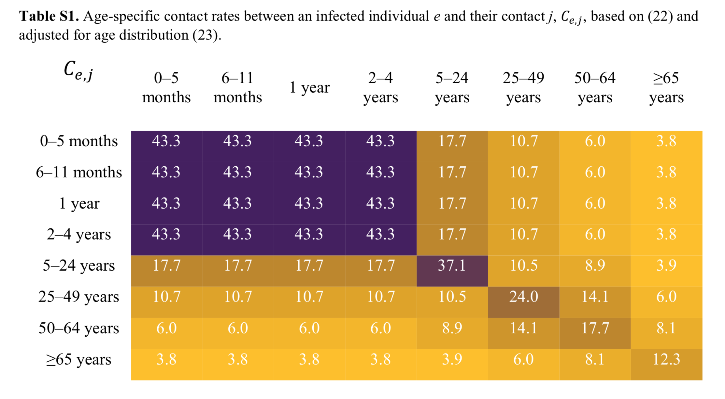
Contact matrix: What might it look like?

Slide 16
Notes:
Daily contact rates from eight European countries

Slide 17
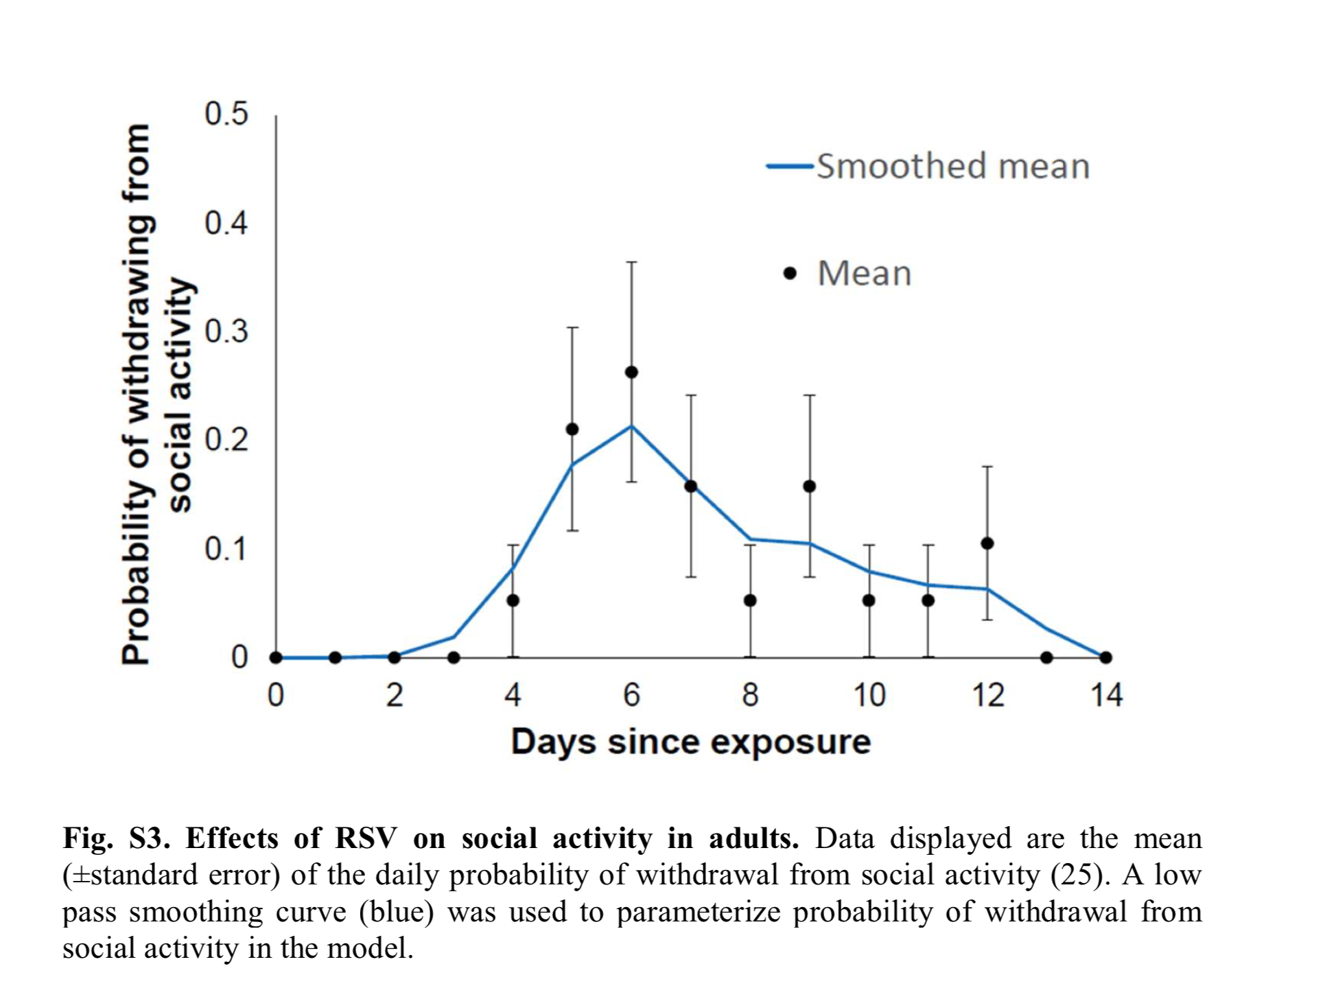
Probability of “social withdrawal”: What might it look like?
Notes:
Arrow where infectious and symptoms start
Latency periods and work hours
Paper of 35 volunteers experimentally infected with RSV, showed highest mean symptom score on day 5

Slide 18
Notes:
35 volunteers were experimentally infected with RSV in the US. Severity of RSV symptoms was measured twice daily for two weeks. For each of these days, we considered that an individual withdrew from social activity if the individual reported that at least one of the symptoms “stop me from participating in activities”.

Slide 19
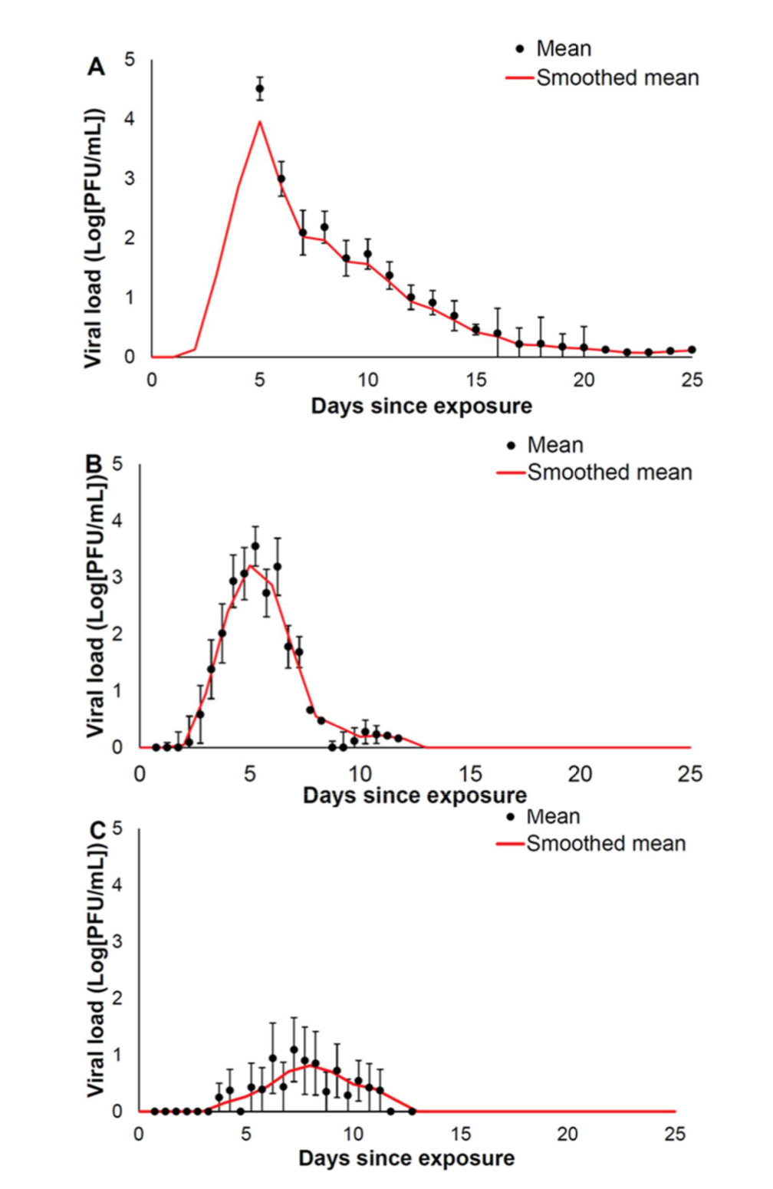
Viral load: What might it look like?
A. First infection
B. Subsequent, symptomatic infection
C. Subsequent, asymptomatic infection
Notes:
Note that the same paper I referred to earlier indicated a strong correlation between viral load and symptoms experienced

Slide 20
A. First infection
B. Subsequent, symptomatic infection
C. Subsequent, asymptomatic infection
Notes:
ID 50 RSV

Slide 21
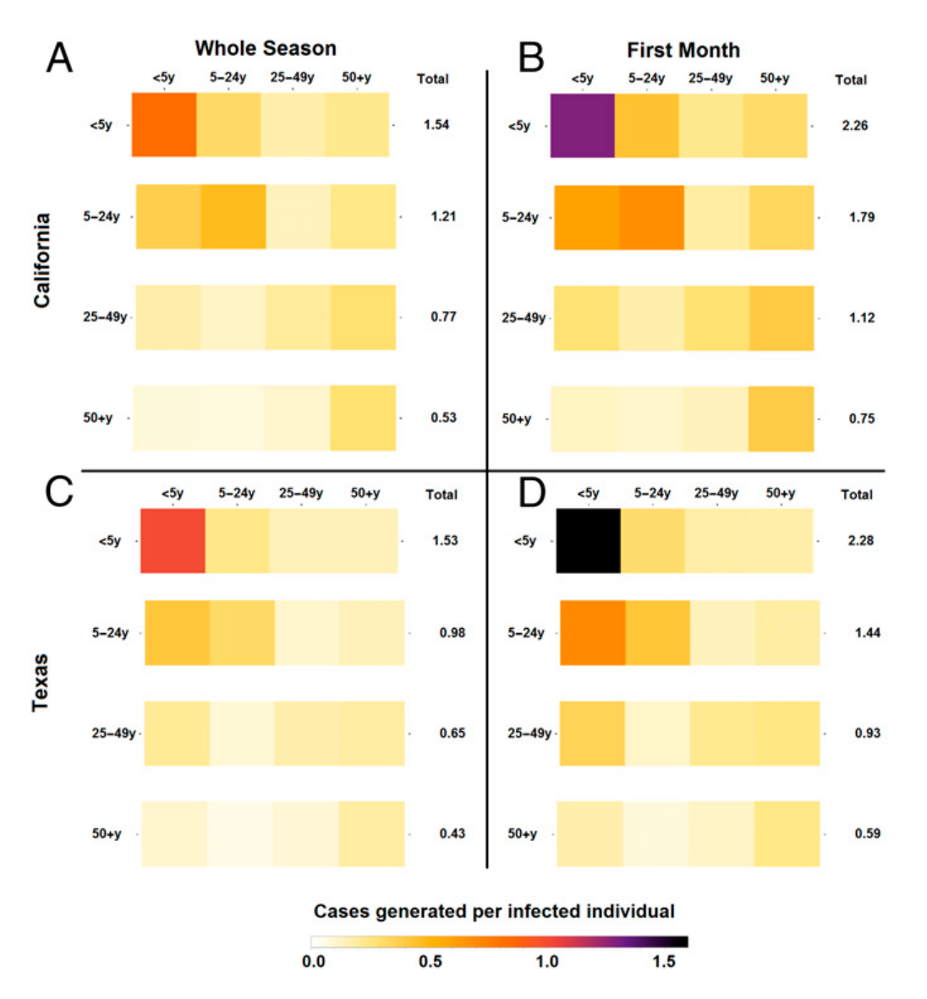
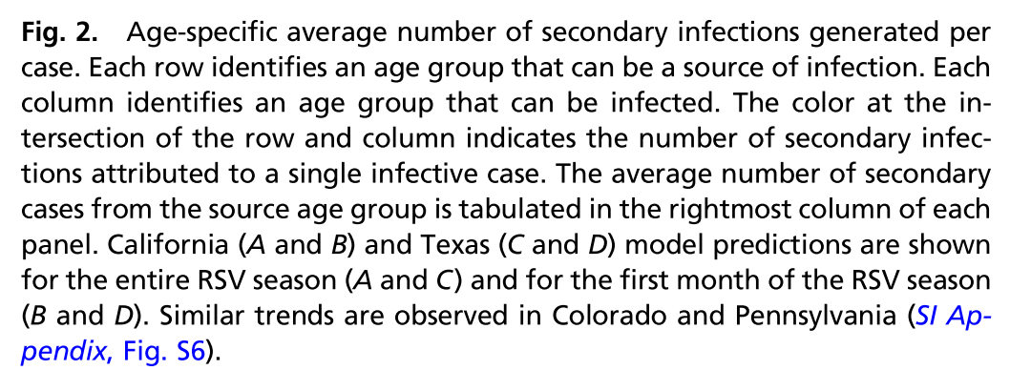
Children <5, highest probability of infection and transmission

Slide 22
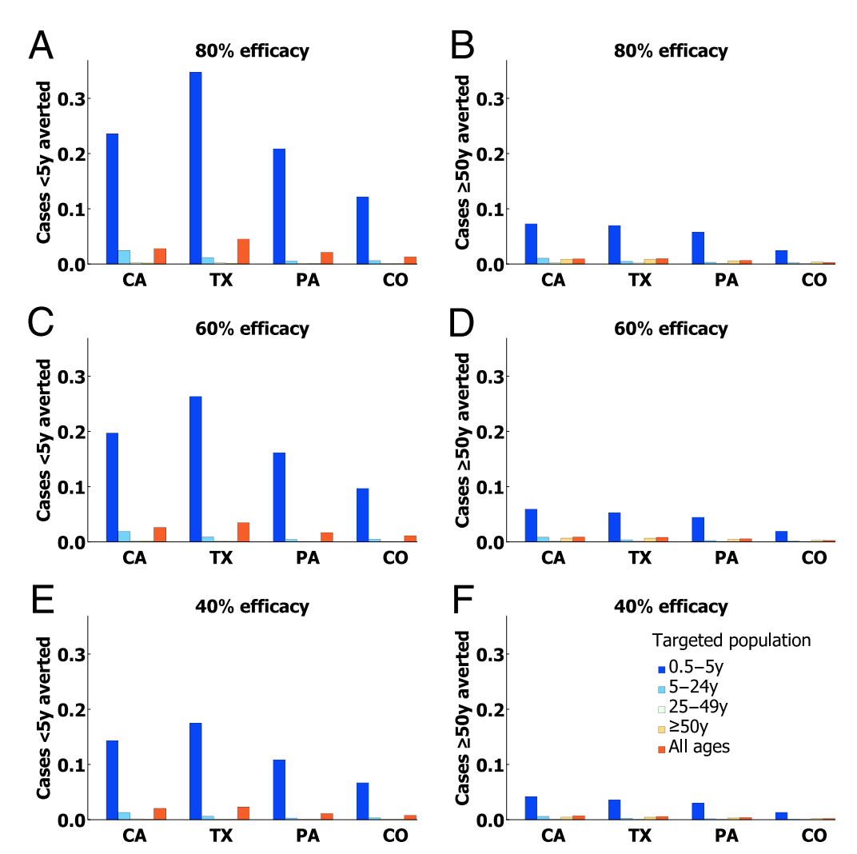
Children <5 as most effective target age for vaccine roll-out
﻿”…vaccinating children between 6mo and 5y of age was found to be more efficient for individuals over 50y of age than vaccinating these adults directly”

